Slide 1




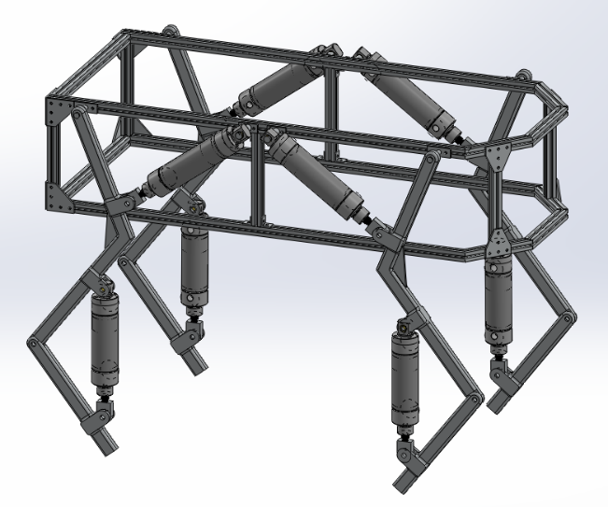
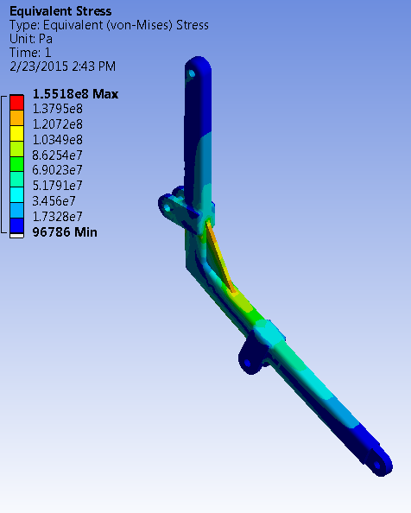
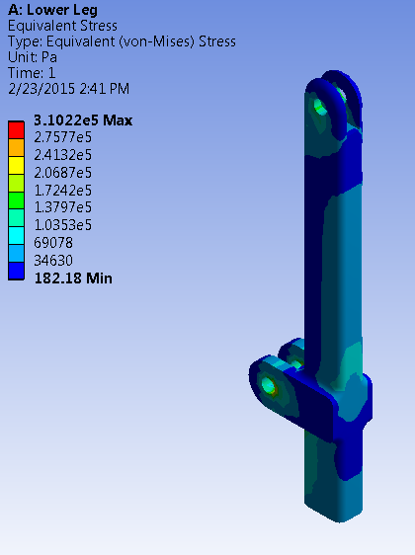
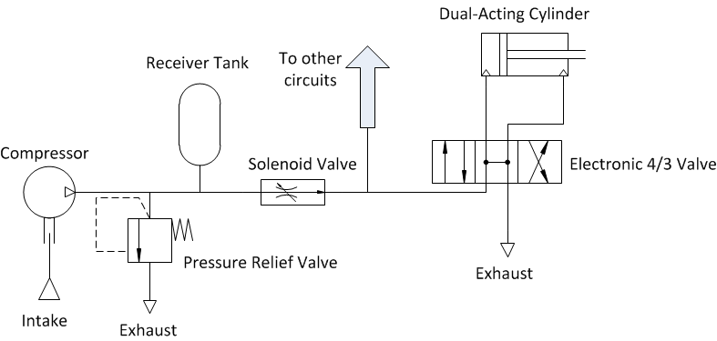
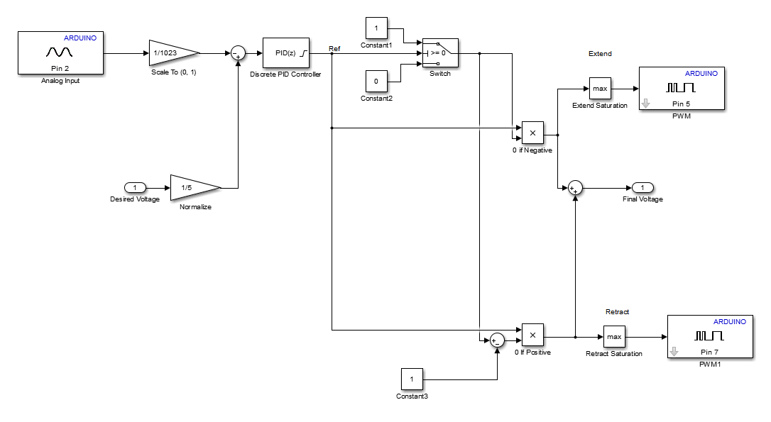
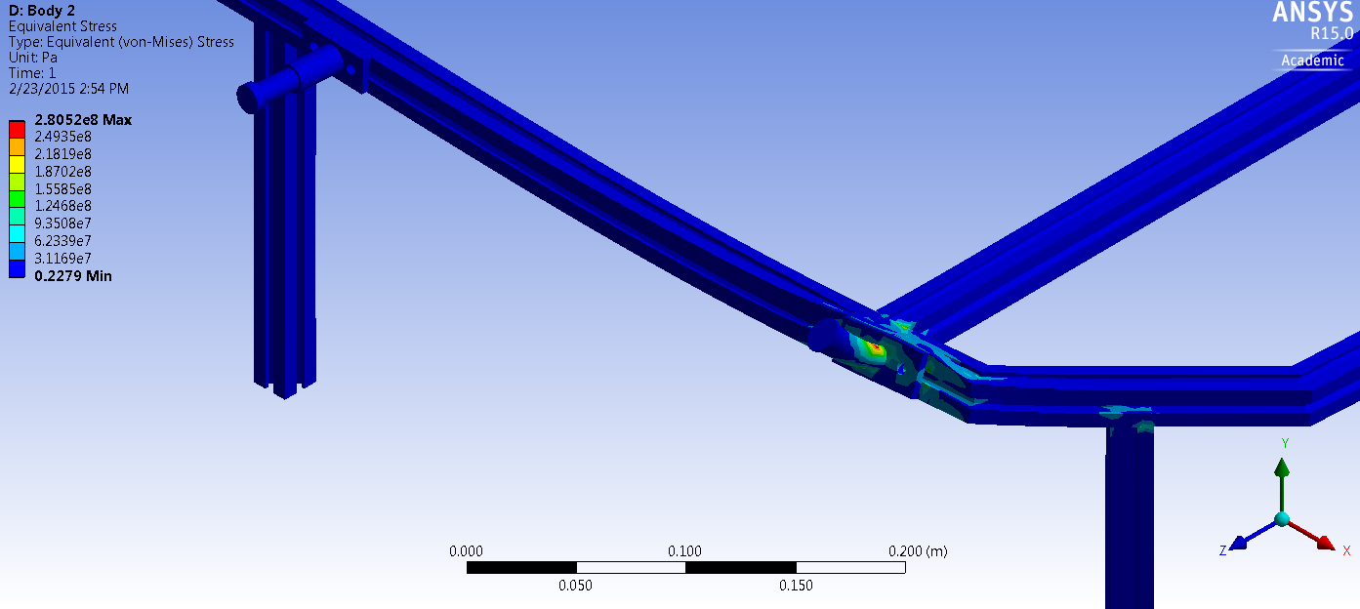
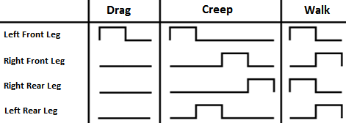
Development of an Agile Pneumatic Educational Robot
Team A.R.C.
Logan Beaver
Justin Campbell
Tyler Paddock
Ronald Shipman
Spring, 2015
Problem Statement
Recently there has been a decline in interest and proficiency related to science, technology, engineering, and mathematics (STEM) fields. According to a 2013 survey by Junior Achievement USA, 46% of US teenagers showed interest in pursuing a STEM or medical related career, which was a 15% decrease from previous years. In addition there is a huge deficit of fluid power engineers in the United States with only 1% of Universities with engineering programs teaching a fluid power concentration. It has also been shown by a study conducted at the University of Nebraska that introducing students to topics in robotics not only improves their attitude towards STEM topics, but also increase their self-efficacy of topics within robotics.
Design Criteria and Constraints
Mechanical
A maximum weight of 35 kg for portability
Maximum speed of 0.5 m/s
Maximum size of 0.75 m x 0.75 m x 1.0 m box for portability
Mechanical protection to reduce the risk of pinching and self-collision damage to the robot
MATLAB and Simulink model support to allow mechanical engineering students to update control algorithms without knowledge of C/C++
A pressure relief valve to reduce the risk of overloading and damaging pneumatic components
Electrical
Electronic fuses and shielding to protect the robot and operator during use and maintenance
Custom debug panel creation to facilitate troubleshooting
An easy to access emergency stop to quickly depower the robot
Human Machine Interface
To control the robot the user sends a direction request to the Java Graphical User Interface (GUI), which encodes the request and wirelessly transmits it to the robot’s onboard Arduino microcontroller. The microcontroller then updates the robot’s desired foot positions based on its current state.
Sequence of Events in Sending a Command
User input is read by a USB controller
Real time Java application parses user input
Application sends commands through an XBee radio module
Partner XBee chip receives the command and sends it to the Arduino microcontroller
Arduino decodes the serial command executes an action accordingly
Objective
To address the existing challenges an educational robotics platform was developed to increase student interest in STEM fields, fluid power, and robotics through outreach opportunities, laboratory exercises, and research experiences.
Arduino Mega 2560
Mechanical Design of Chassis
Chassis Construction
6105-T5 T-Slotted Aluminum Framing (Yield Strength = 275 Mpa)
6061 Aluminum Plate (Yield Strength = 276 Mpa)
Leg Construction
6061 Aluminum Bar (Yield Strength = 276 Mpa)
Leg Pneumatic Circuit
Using pneumatic systems as the driving force for the legs, the following components will be utilized:
Double-acting, air cylinders with position feedback sensors (1.5 in. bore diameter)
Two-solenoid 4 way 3 position directional control valves (0.37 C_{v})
Air-compressor
Pressure relief valve
Soft start/dump solenoid valve
Secondary receiver tank
XBee
XBee
High Level Communication System Diagram
Control Architecture: Two Link Leg
Mathworks Simulink model is loaded onto the Arduino
Utilizes PID feedback loops to control cylinder lengths
Desired length is calculated by a state machine based on user input and current length
Pneumatic Circuit Diagram
Stability and Gait Development
In order to ensure dynamic stability for the robot the Zero Moment Point (ZMP) method was used. The zero moment point can be calculated from the reaction forces acting on each foot. The location where the torque induced by these reactions is zero is the ZMP. In low speed applications such as this one the ZMP can be approximated by the center of gravity (CG). As long as the CG falls within the convex polygon created by the robot’s contact points with the ground it is in a statically stable pose. When the CG passes outside of this polygon an unbalanced tipping moment is created and the robot becomes unstable.
Control Subsystem For a Single Leg
Conclusion
Robots are hard. No, seriously.
Convex Support Polygon
Tipping Moment
Electrical Design
Center of Gravity
The electronics of the robot are separated into subsystems. The communication subsystem, microcontroller subsystem, motherboard subsystem, and debug panel subsystem. The communication subsystem interfaces a user controlled computer with the Arduino microcontroller using Xbee modules. The microcontroller subsystem includes the microcontroller, Xbee shield, and battery supply for the microcontroller. This microcontroller battery supply is implemented as a standard replaceable 9 volt battery. The motherboard subsystem handles to signal conditioning for the command and feedback signals.
The microcontroller uses a pulse width modulated signal with a varying duty cycle to indicate an open or close command to each of the eight pneumatic valves. The motherboard’s signal conditioning hardware includes a third order active low pass filter to convert the pulse width modulated signal into an analog signal. This analog signal is then scaled by another amplifier circuit to the proper magnitude for the pneumatic valve. The current extension of the pneumatic cylinder is reported as feedback to the microcontroller. This feedback signal passes through an analog filter to scale down the voltage for the Arduino.
A debug panel is included to provide electrical access to the command and feedback signals to and from the pneumatic cylinder. Additionally the debug panel has a toggle switch for the microcontroller battery, status LEDs, battery level LEDs, and an emergency stop a higher power battery bank that powers the pneumatic valves.
Points of Contact
Future Work
Controlling the robot with a cellphone application
Integrating gyroscopes and force sensors to determine real time stability
Foot trajectory optimization
Mechanical design optimizations
Implementation of dynamically stable but statically unstable gaits
CAN network development
Air supply mounting on robot chassis
External disturbance resistance
Feed forward control design and implementation
Autonomous navigation
Embedded valve driver creation
Top and side view of the robot model’s convex support polygon and an induced tipping moment. The tipping moment is caused by the center of gravity being outside of the convex support polygon.
The four gaits examined during the project were drag, creep, and walk. A diagram of leg actuations can be seen below for each gait:
Three slow gait patterns for a four legged robot. The drag and creep gait involve moving a single leg, and are statically stable. The walk gait involves moving two legs at once, and is dynamically stable.
Acknowledgements
Special thanks to Joy Global, Inc., the National Fluid Power Association, Emerson, Otto J. Maha Endowment Fund, MSOE, and Dr. Luis A. Rodriguez for their support

